Slide 1
COMP90082 PROJECT
PLANIMATION
Team: PL-Bluering
901054 Shujin Zhang
1001913 Priyanka Shivampetha
1122396 Zenan ji
1104891 Yinghao Wang

Slide 2
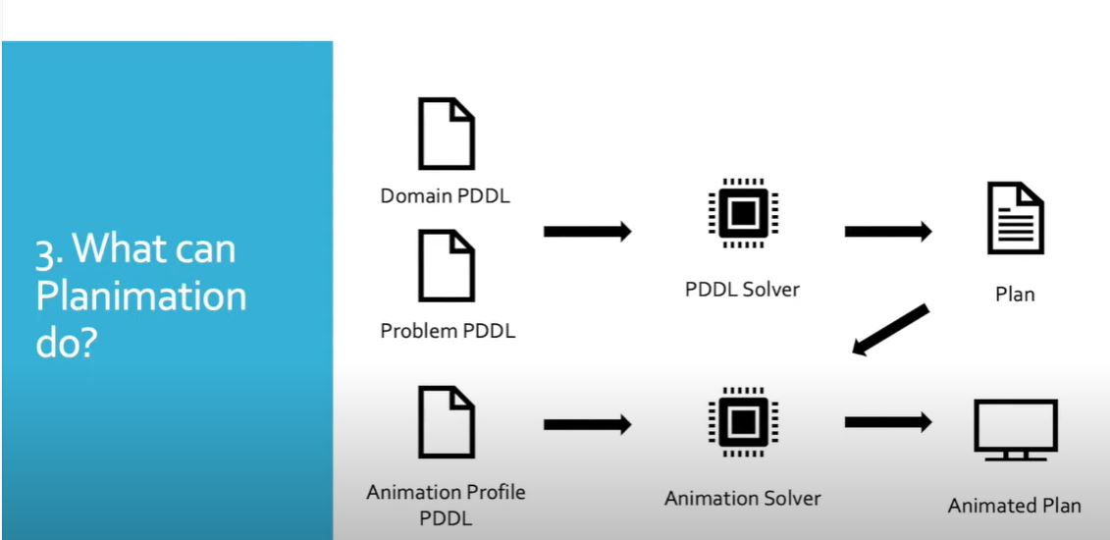
INTRODUCTION
What is planimation?
Planimation it is open source program which is used to visualises solutions for planning problems.
Planimation currently has a animation for four planning domains:Blocks,grids,tower of hanoi and logistics.
Who are Users for the planimation:
Researchers in planning models.
Students in learning problems.
Industry partners in showing problems.
What does planimation allows users to do?
Allows the user to check error in pddl editor.
For every problem of a specific domain,planimation creates a general animation.
Planimation allows users to encode new animation.
Notes:
Researchers uses a pddl planning need to work with text based solutions which makes hard them to understand the dynamics represented by the action and to identify model errors and planimation solves it introduces animation profile and animation solver which will convert the text based plan into the animated plan.
The animation plan is represented in pddl syntax it helps user to define animated actions based on 3 parts predicate rules (specify the animation behaviour),visual objects (define the object and its attributes like x,y,width,height,name) and base 64 image.
Planimation is intended to make solutions more amenable to humans interacting with planners,and assist in modelling process as well as education of AI planning.

Slide 3
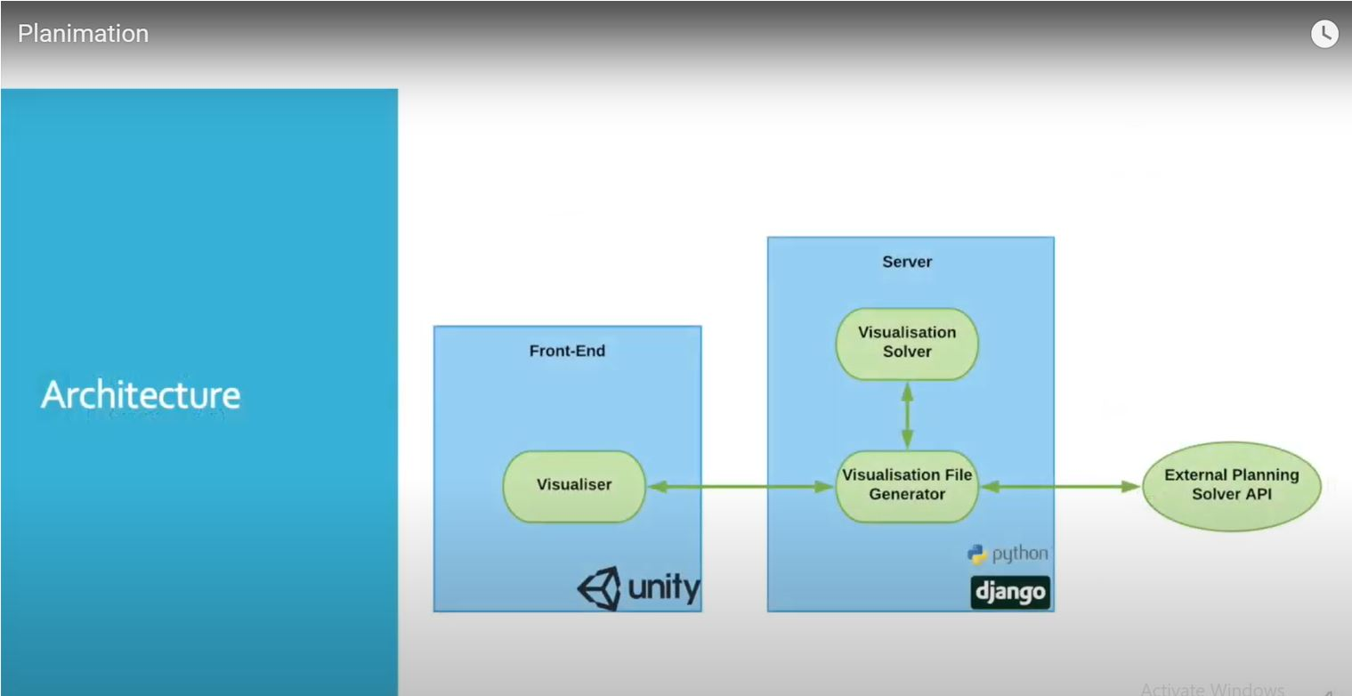
Architecture of Planimation

Slide 4
Planimation Team Details
Client Details:
Dr. Nir Lipovetzky
Nir Lipovetzky is a senior lecturer at university of melbourne.Nir lipovetzky has an interest in research areas in AI planning,learning, verification and is also involved in the project development of lightweight automated planning tool kits.
Team Details:
Shujin Zhang (Product Owner)
Priyanka Shivampetha (ScrumMaster & Architectural lead)
Zenan ji (Architecture Lead & Developer).
YingHao Wang (Quality Assurance Lead & Deployment Lead)
Supervisor Details:
Doc Wallace

Slide 5
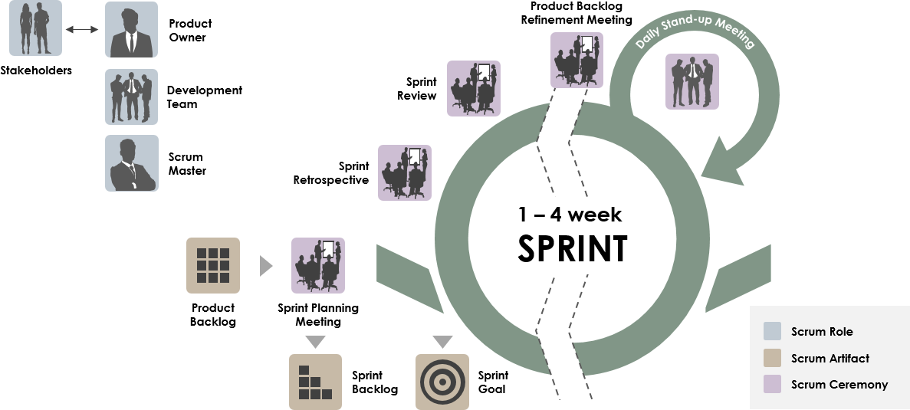
ROLES AND RESPONSIBILITIES
For this project, our team has chosen a agile methodology and the team roles are:
Product owner
Scrum master
Architectural lead
developer
Quality Assurance Lead
Notes:
Responsible that each team member understands the agile process and team members are well trained.
Responsible for that team following scrum practices and principles.
Conduct daily stand-up meetings, sprint planning meetings, sprint retrospective meetings, and responsible to conduct meetings for every sprint and make sure the goal of the project is attained.
Responsible for creating burn down chart
Responsible that team should not slow down during the sprint process and team members are active and functional.
Is responsible to remove any roadblocks which can impede the progress of the project.
check the testing and software quality of the product.

Slide 6
Client Requirements
REQUIREMENTS:
VSCODE plugging for PDDL integration with the plugging.
Scope keep the functionality of current frontend
Import VFG format (visualization files)
Expecting implement PNG export
Maintain two visualization access
IN SCOPE REQUIREMENTS:
Integrate the planimation module as vscode plugin.
Pddl editor plugin
Load and use the planimation module
Build the visualisation from problem files.
Build visualisation from solution vfg file.
Export animation feature
Demo files
OUT OF SCOPE REQUIREMENTS:
Modification of Backend.

Slide 7
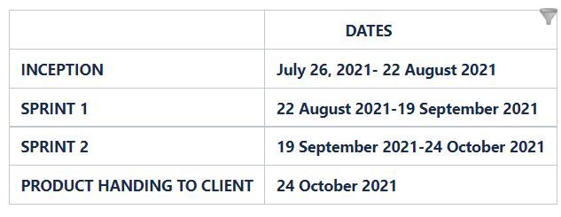
TIME DURATION FOR PROJECT

Slide 8
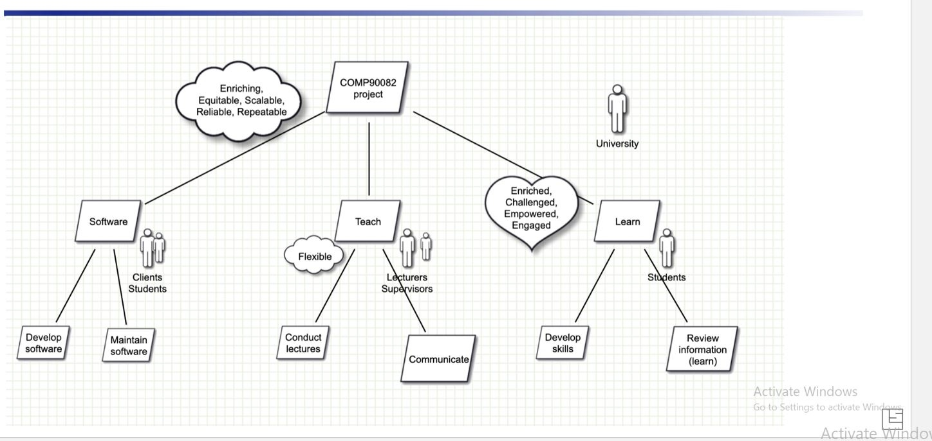
Goal Model
From the goal model we have 3 roles, i.e student, supervisor and client and their relationship to the product.
How does a student interact with the product?
How does a supervisor interact with the product?
How does client interact with the product?

Slide 9
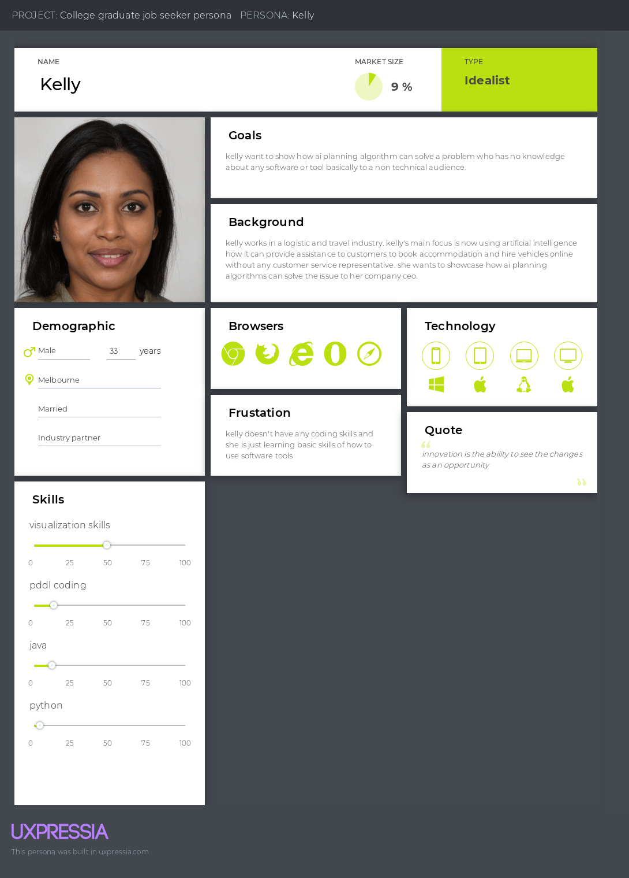
How industry partner can use a planimation
Notes:
kelly works in a logistic and travel industry. kelly's main focus is now using artificial intelligence how it can provide assistance to customers to book accommodation and hire vehicles online without any customer service representative. she wants to showcase how ai planning algorithms can solve the issue to her company ceo.
The goal kelly want to show how ai planning algorithm can solve a problem who has no knowledge about any software or tool basically to a non technical audience.
The frustration kelly doesn't have any coding skills and she is just learning basic skills of how to use software tools

Slide 10
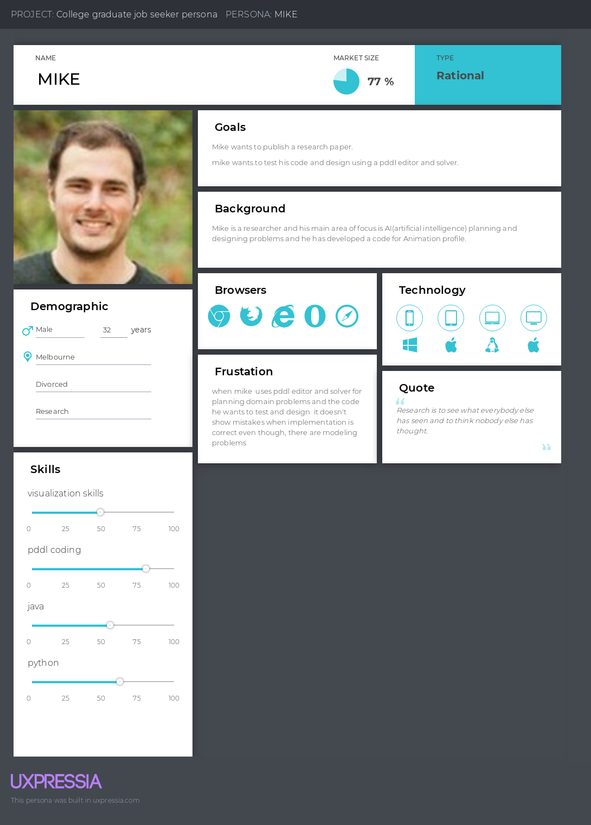
How researcher uses planimation
Notes:
Mike is a researcher and his main focus area is artificial intelligence planning and designing problems and he has developed a code for animation profile
The goal is Mike wants to publish his own research paper in Ai problems.
mike wants to test his code and design using pddl editor and solver
The frustration is when mike uses pddl editor and solver for planning domain problems and the code he wants to test and design it doesn't show any error when implementation is correct even though there are modelling problems

Slide 11
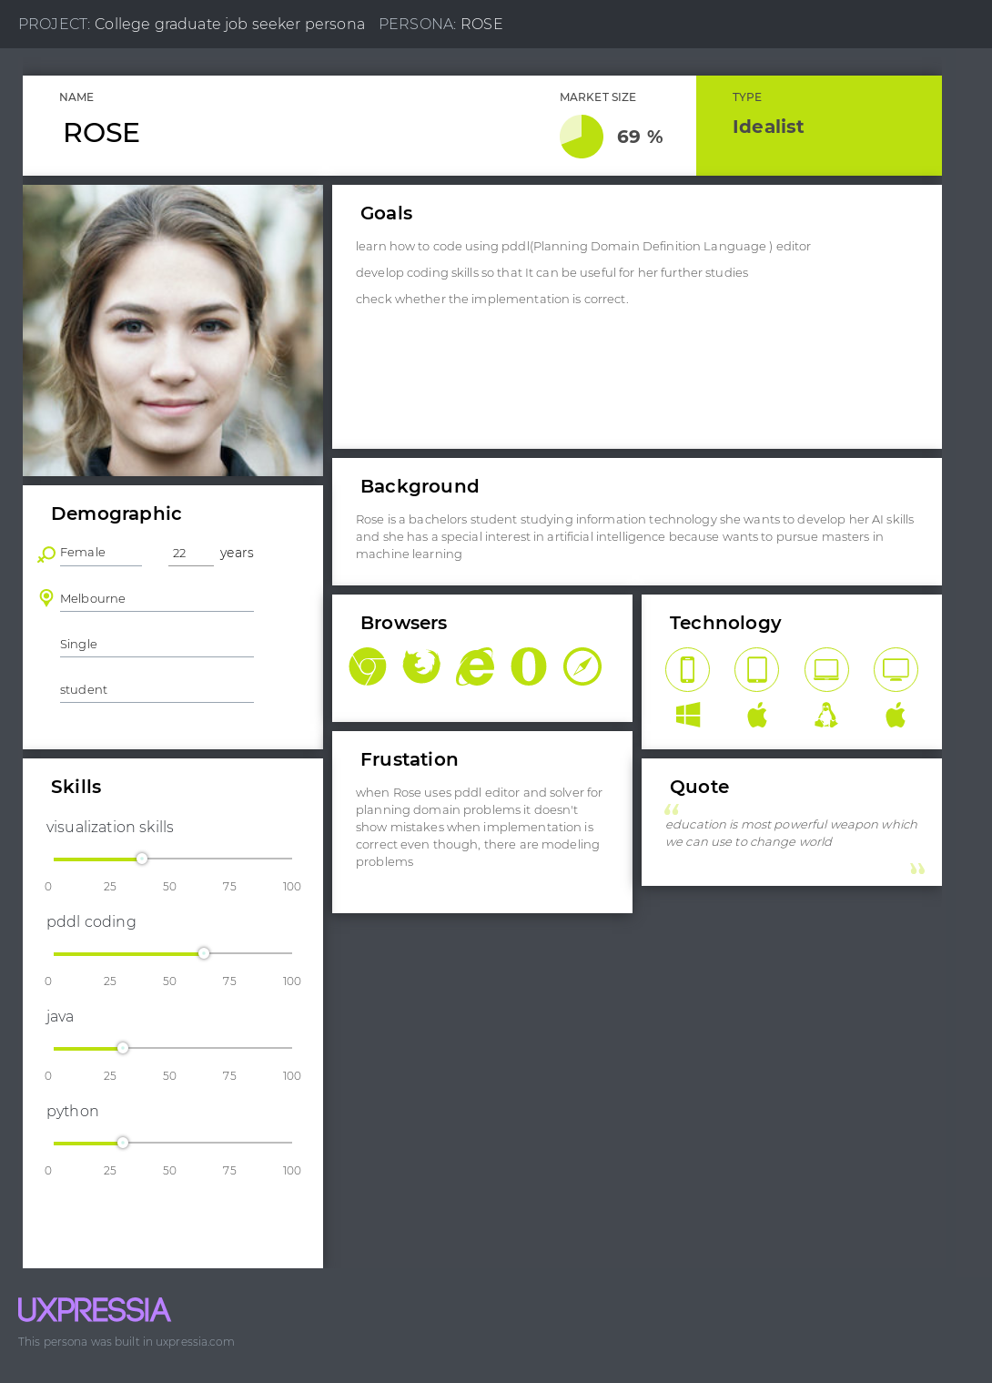
How student uses planmation
Notes:
Rose is a bachelor student studying information technology as she wants to develop her AI(artificial intelligence skills) as she has a special interest in persuing masters in machine learning
The goal is learn how to use pddl editor
develop coding skills which can be useful for her further studies
check whether the implementation are correct.
The frustration is when rose uses pddl editor and solver for planning domain problems it doesn't show any error when implementation is correct even though there are modelling problems

Slide 12
USE CASE SCENARIOS
Users can build the basic visualisation from the problem files.
Users can access demo information so that they can learn about the tool.
Users can build the visualisation from vfg files.
Users can export the animation
Users can also manipulate the animation during the execution time.

Slide 13
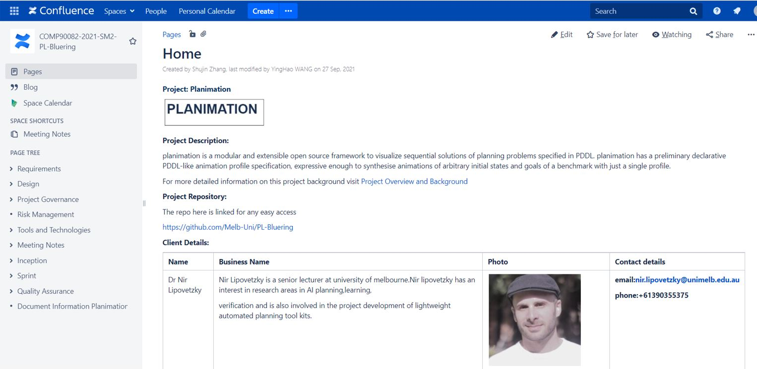
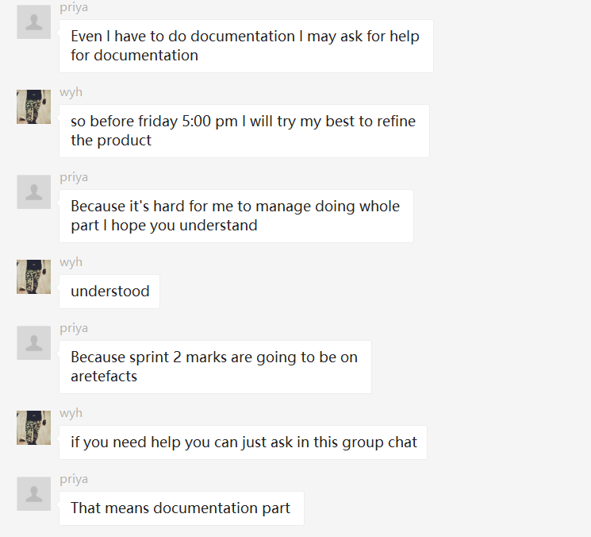
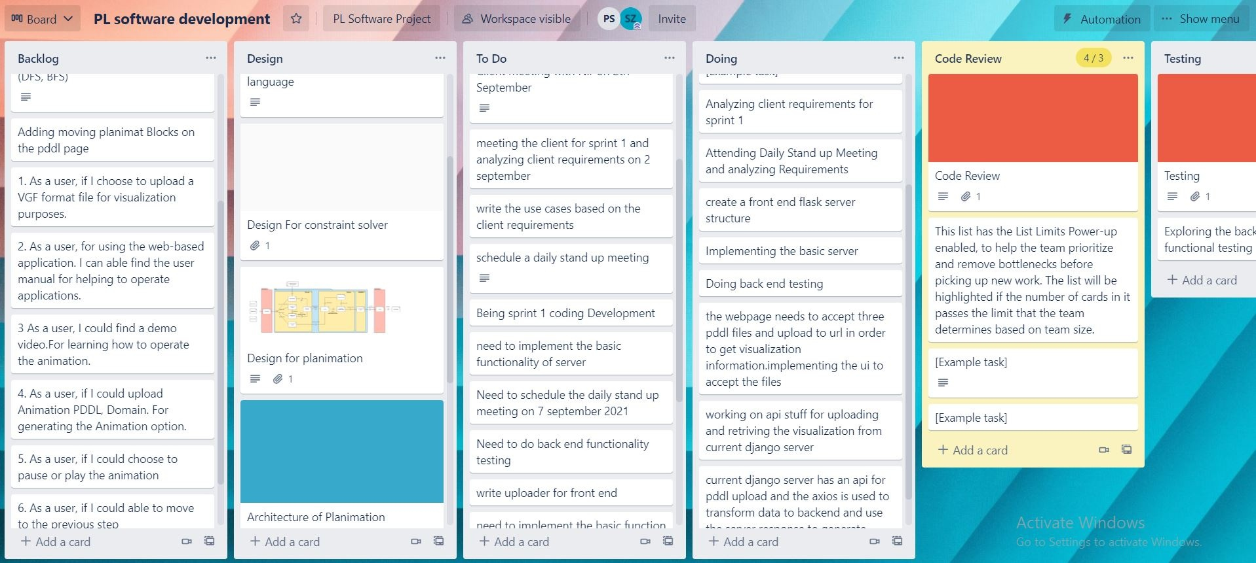
COMMUNICATION PLAN
For this project team has used confluence,trello and Wechat.
Confluence:The team has used for updating the design,user stories,use cases specifications and goals of the project.
Notes:
Confluence:The team would be used for updating the design,user stories,use cases specifications and goals of the project.
Trello:During the development stage the team would be using Trello for assignments and distribution of tasks and Trello is linked to slack, github
Slack, gmail and wechat:The team would be using it for communication.
Zoom and google call: Online meetings tools for team members.

Slide 14
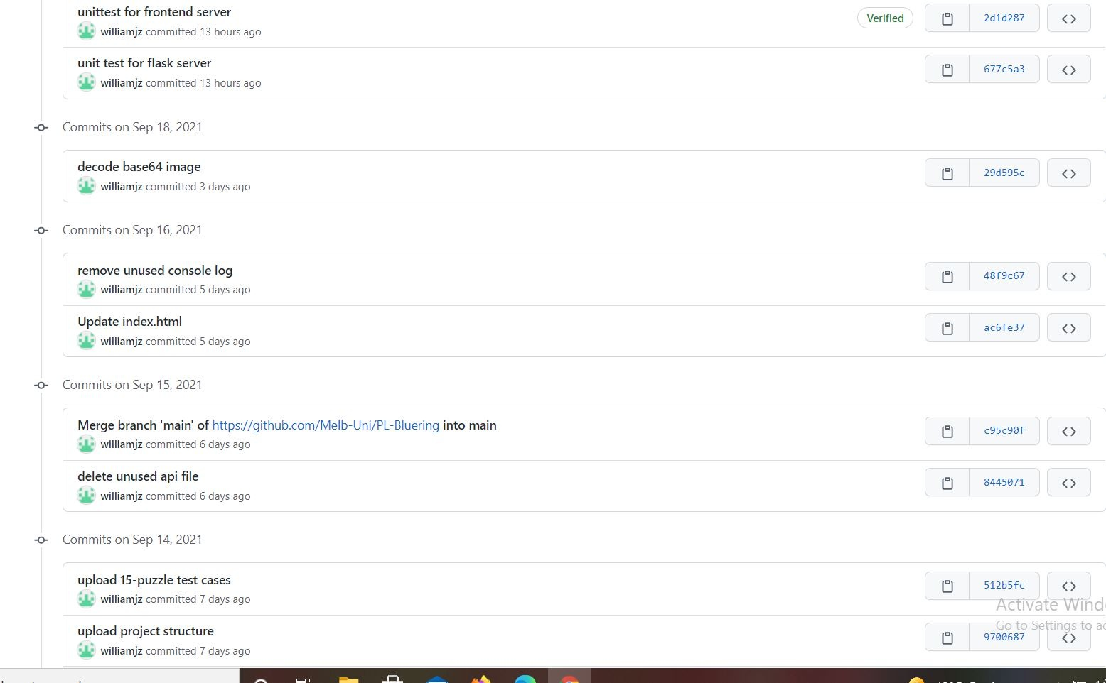
GitHub

Slide 15
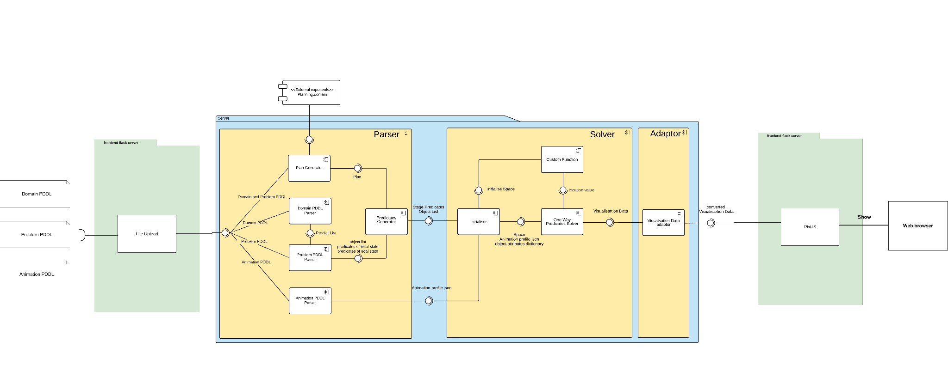
PROTOTYPE DESIGN

Slide 16
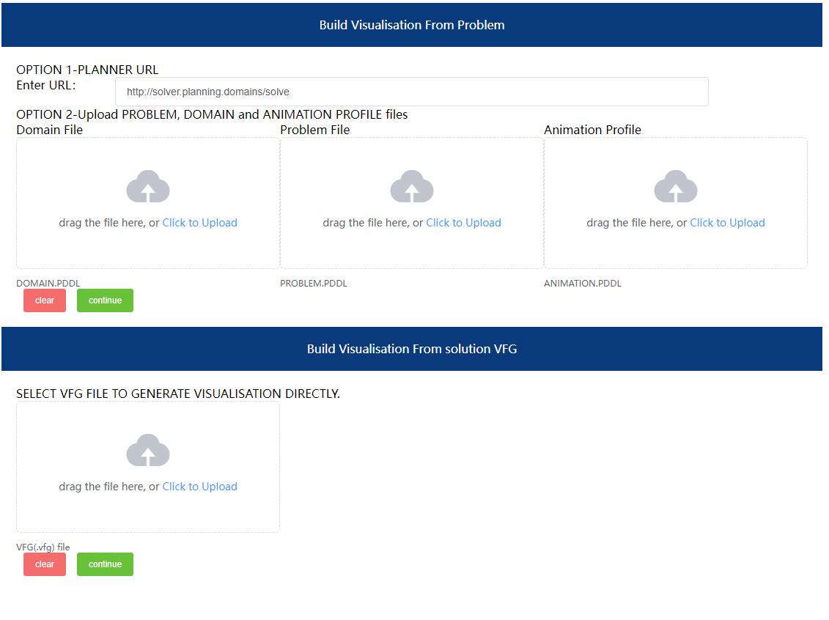
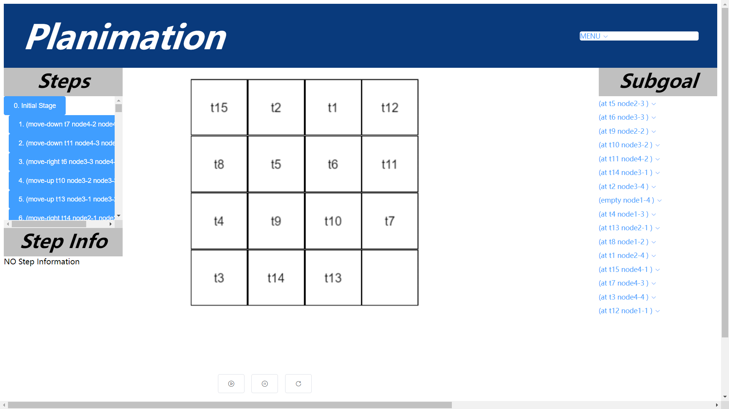
What was delivered

Slide 17
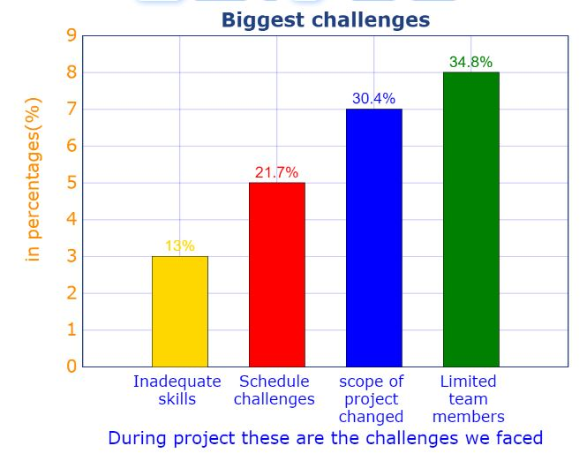
Key Challenges
During the project our team had faced some key challenges:
Inadequate skills of a team members
Limited team members(as we have only 4 members for this project compare to other groups)
The scope of the project has been changed.
Schedule challenges.
Unrealistic deadlines
Notes:
For Inadequate skills of a team members during starting of the project as the team members didnt have a knowledge on the software languages like javascript so team before starting a project has taken a time to gain some knowledge about javascript.
We have a limited team members compare to the other groups we only have 4 members in the team it was a quite disadvantage to us.
The client requirements has been changed during sprint 2 which was first to add the vscode plugin but later as the client thought we and other team members were doing similar work has changed the requirements to adding some more animation profiles.
The team members are currently enrolled in full time course and they have other subjects as well and due to that there was a challenge in scheduling a team meetings.
For the sprint 2 the client has changed the requirements before a week of sprint 2 as it was quite unknown and the team needs to work harder for accomplishing the features so it was a unrealistic deadlines.
Due to the current covid situation the current learning has been made online so it is difficult for the whole team to communicate together as some of the team members are living in different countries so it would be difficult to communicate due to time zones and implement the project together so technically it could affect the efficiency of the team during development stage.

Slide 18
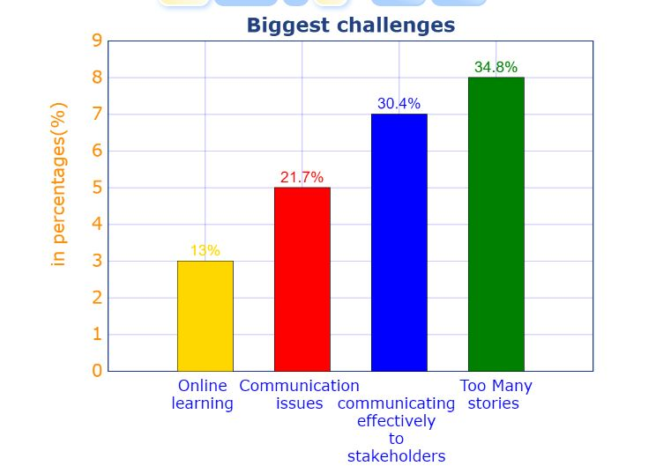
Key Challenges
During the project our team had faced some key challenges:
Online learning
Communication issues
Communicating effectively to stakeholders
Too many stories at the start of the sprint.
Notes:
Due to the current covid situation the current learning has been made online so it is difficult for the whole team to communicate together as some of the team members are living in different countries so it would be difficult to communicate due to time zones and implement the project together so technically it could affect the efficiency of the team during development stage.
As there was no clear communication with the client so we and other team members ended up doing same development of features
Initially based on requirements from client there were too many user stories.

Slide 19
Key Accomplishments
The key accomplishments during project:
Team members had gained a real time experience working on a project.
Team members have gained valuable development coding skills.
Team has met the client requirements during product demo.
Team members have developed Teamwork skills,communication skills and interpersonal skills by working on this project.
Team members have try to accomplish the client requirements even though there was a change in a scope of project.

Slide 20
Thanks for listening!

